Slide 1

Question Answering System
Meghana
Sravani
12/05/2022

Slide 2
Project Description
This project presents our experiments in developing a question-answering (QA) system which aims at replying to questions on services offered by a website.
Our system is an instance of closed-domain QA, which works on a document collection restricted in subject and volume.
In closed-domain QA, correct answers to a question may often be found in only very few documents; the system does not have a large retrieval set abundant of good candidates for selection.
Moreover, if the QA system is to be used for answering questions from a company's clients, it should accept complex questions, of various forms and styles.
The system should then return a complete answer, which can be long and complex, because it has to, e.g., clarify the context of the problem posed in the question, explain the options of service, give instructions or procedures, etc.

Slide 3
Question Answering?
An automated question-answering system can replace human efforts.
Building a reliable and efficient QA system is a challenging task. Its performances are directly related to the quality of integrated tools for finding the answers and the depth of all involved NLP resources.
When dealing with such a system and developing it, many arising questions should be answered, and multiple objectives should be fulfilled.
In this project we build a flexible QA model that can adapt to different closed domains and train on their corpora.

Slide 4
Goal
What would be the approach to Question Answering task where input context or paragraph is n-times bigger or smaller than 512?
How to adapt the BERT model for domain-specific QA dataset with a limited amount of domain-specific corpus (only product documents or only clinical notes)?
Does replacing the placeholders in BERT’s vocabulary with the frequent domain-specific words help?
How much training data is needed to achieve decent accuracy?

Slide 5
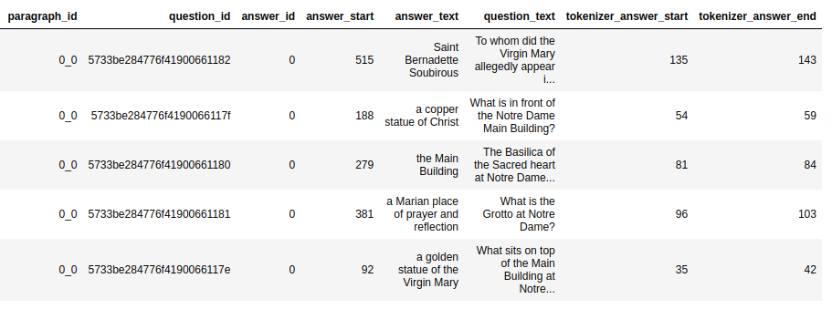
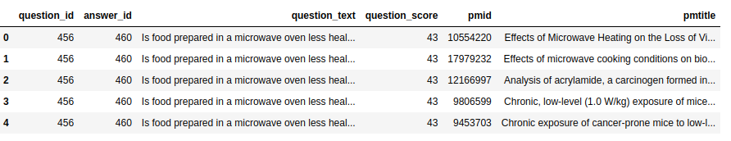
Dataset
SQUAD-2
Combined multiple Medical QA datasets for fine tuning
MedQuAD – 47 k
MEDIQA2019 - 10k
BiQA – 13k samples

Slide 6
Implementation
BERT architecture
First Step - Evaluating performance of the SQUAD finetuned BERT-QA model on medicalQA.
Second Step - SQUAD finetuned BERT-QA model on medicalQA.
Evaluating model performance on Fine-tuned model with medicalQA dataset

Slide 7
Evaluation Methodology
We adopt our model two metrics including Exact Match (EM) and F1 scores to evaluate our model.
The EM score determines the percentage of predictions that perfectly match the ground truth answer, and the F1 score demonstrates the average overlap between the prediction and the ground truth answer.

Slide 8
Results
We adopt our model two metrics including Exact Match (EM) and F1 scores to evaluate our model.
The EM score determines the percentage of predictions that perfectly match the ground truth answer, and the F1 score demonstrates the average overlap between the prediction and the ground truth answer.
Measure | Test Scores on MedQA
exact | 61.20
f1 | 67.39
total | 5000

Slide 9
Conclusion
Models trained on the general domain dataset do not perform well on the domain-specific datasets.
To adapt to the medical domain, task-driven fine-tuning with medical domain-specific QA dataset is one of the most important steps.
Medical Domain adaptation by Language Model training with limited data (with only available paragraphs or clinical notes from QA dataset) gives a marginal improvement in performance.
Fine-tuning the BERT-QA model with a large Medical domain QA dataset before fine-tuning on domain-specific QA dataset can prove helpful when the domain-specific dataset is limited.

Slide 10
References
https://web.stanford.edu/class/archive/cs/cs224n/cs224n.1174/reports/2760988.pdf
https://towardsdatascience.com/the-definitive-guide-to-bi-directional-attention-flowd0e96e9e666b
https://web.stanford.edu/class/cs224n/materials/CS224N_PyTorch_Tutorial.html
https://arxiv.org/pdf/2005.00574.pdf
https://portal.dbmi.hms.harvard.edu/projects/n2c2-nlp/
https://ieeexplore.ieee.org/document/9762943

